Slide 1
معرفی بندپایان مهم برای دانشجویان رشته پزشکی
Edited by Rouhullah Dehghani Professor of Environment Health Department, Kashan University of Medical Sciences

Slide 2
نام درس : حشره شناسي پزشكي
هدف كلي :
دانشجو در پايان دوره با گونه های مهم بندپایان پزشکی و نحوه آسیب آنها به انسان و چگونگي انتقال عوامل بيماري زا آشنا شود

Slide 3
اهداف جزئی یا رفتاری
دانشجو در پايان دوره :
1-اهمیت آموزش حشره شناسی پزشکی در دوره آموزشی را بيان كند
2- نحوه انتقال بیماری ها توسط بندپایان شرح دهد
3-عوامل ناقل بيماري و عوامل بيماري زا در شاخه بندپايان توضيح دهد .
4- عوامل بيماري زائي منتقله بوسيله بندپايان را ليست نمايد .
5- عوارض و بیماری های منتقله بوسیله ، کژدم ها، عنکبوت ها، کنه ها ، مایت ها، سوسری ها، شپش ها، ساس ها، پشه ها، مگس ها ، کک ها ، زنبورها و پروانه ها فهرست نماید

Slide 4
منابع :
1ـ حشره شناسي پزشكي ـ تاليف م ـ سرويس ترجمه دكتر زعيم دکتر رشتي ـ دکتر صائبي (1377). انتشارات دانشگاه تهران
2-آفات بهداشتی و روش های مبارزه پاک با آنها، تاليف دكتر روح اله دهقاني(1390). انتشارات فرمنش تهران و دانشگاه علوم پزشكي كاشان. 478صفحه
3-مقدمه ای بر بندپایان آبزی، تاليف دكتر روح اله دهقاني(1391). انتشارات فرمنش تهران و دانشگاه علوم پزشكي كاشان. 372صفحه
4-حشره شناسی پزشکی (ریخت شناسی ، فیزیولوژی واهمیت پزشکی) برای دانشجویان گروه پزشكي و بهداشت تاليف دكتر روح اله دهقاني(1392). انتشارات فرمنش تهران و دانشگاه علوم پزشكي كاشان.

Slide 5
References
8-Medical Insects and Arachnids (1996). Richard P.Lane and Roger W. Crosskey. Chapman and Hall , pp723
9-Medical Entemology for Students .(2002) .M.W. Service ,Chapman and Hall , pp277
10-A Colour Atlas of Tropical Medicine and Parasitology (1991).W. Piters and H.M.Gilles,Wolfe Medical Publications Ltd.

Slide 6
Entomology the branch of zoology concerned with the study of insects
Entomology (Entom+logy) .(from Ancient Greek (entomon) 'insect', and (-logia) 'study of is the scientific study of insects, a branch of zoology. entomology included the study of terrestrial animals in other arthropod groups or other phyla, such as arachnids, myriapods and crustacean .

Slide 7
Medical Entomology - the study of diseases caused by arthropods
Public health Entomology - arthropods and human health
Veterinary Entomology - arthropods and pets, livestock and wildlife
Medico criminal Entomology or Forensic Entomology
These fields of study are linked by the ecology of most arthropod transmitted pathogens and parasites.

Slide 8
Why is Entomology important to we
About one third of the world's crop production depends directly or indirectly on pollination by insects.
The overall value of pollination in the world, most of it by insects, has been estimated at about $117 billion per year .
The overall value of natural biological control, again mostly by insects, is over $400 billion per year .

Slide 9
The value of nutrient cycling in terrestrial ecosystems is over $3 trillion per year.
As pests and human competitors they destroy or eat $5 billion;
As disease vectors, insects weaken or kill 200 million people per year..

Slide 10
What is an Arthropod? The word "arthropod" comes from two Greek words, arthro (jointed) and pod (foot). Arthropods(arthro+pod)
The Arthropods are the largest and most successful Phylum on this planet comprising 80% of the animal Kingdom.
An Arthropod is an animal that possesses these characteristics A) a mouth and anus at opposite ends of a through gut., B)a hard jointed exoskeleton, C) jointed limbs.
They range in size from less than a millimeter to the giant Japanese spider crab, an animal with a legspan of more than 4 meters

Slide 11
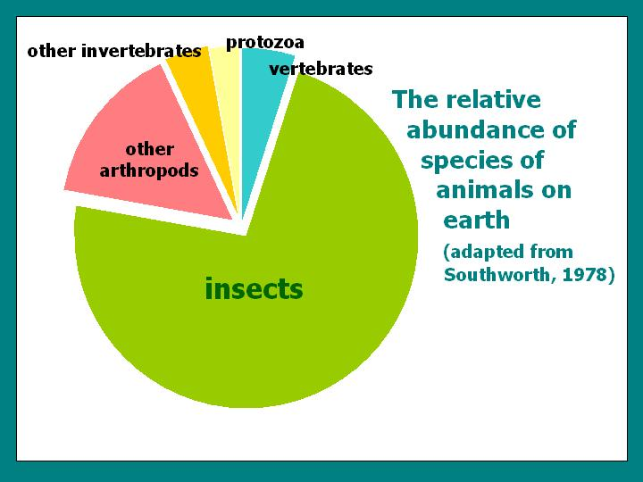

Slide 12
Importance of Arthropoda
Useful (positive aspects)
direct (food, honey and silk production, Apitherapy (Apis mellifera) )
indirect (control of other harmful arthropods)
Neutral
Harmful (negative aspects)
Indirect( loss of food productivity)
Direct:
1-Contact
2-Sting or Bite
3-Pathogen or Agent
4-Vector

Slide 13
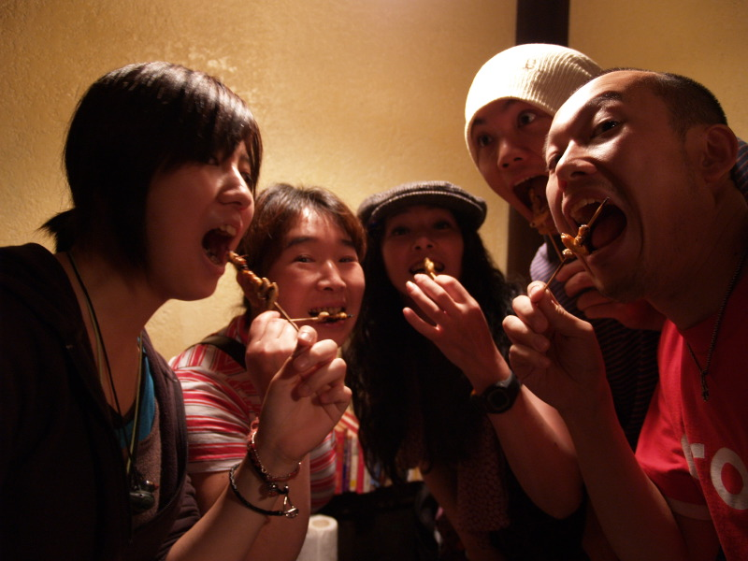

Slide 14
ارزش غذایی حشرات مختلف در 100 گرم
حشره | پروتئین(g) | چربی (g) | کربوهیدرات | کلسیوم (mg) | آهن (mg)
سوسک آبزی بزرگ | 19.8 | 8.3 | 2.1 | 43.5 | 13.6
مورچه قرمز | 13.9 | 3.5 | 2.9 | 47.8 | 5.7
پوپ کرم ابریشم | 9.6 | 5.6 | 2.3 | 41.7 | 1.8
سوسك‌ سرگين‌ خور | 17.2 | 4.3 | .2 | 30.9 | 7.7
جیرجیرک | 12.9 | 5.5 | 5.1 | 75.8 | 9.5
ملخ کوچک | 20.6 | 6.1 | 3.9 | 35.2 | 5.0
ملخ بزرگ | 14.3 | 3.3 | 2.2 | 27.5 | 3.0
June سوسک | 13.4 | 1.4 | 2.9 | 22.6 | 6.0
پروانه (Not available) | 6.7 | N/A | N/A | N/A | 13.1
موریانه | 14.2 | N/A | N/A | N/A | 35.5
شپشه گندم | 6.7 | N/A | N/A | N/A | 13.1
گوشت (Lean Ground) | 27.4 | N/A | N/A | N/A | 3.5
ماهی (Broiled Cod) | 28.5 | N/A | N/A | N/A | 1.0

Slide 15
Apitherapy, the medicinal use of honey bee products, has been practiced since ancient times.
In the modern world honey bee venom has found wide uses in treating arthritis and other inflammatory and degenerative diseases.
The world scientific literature contains more than 1500 articles on bee venom.

Slide 16
Contact

Slide 17
Spider Bite

Slide 18
Scorpion Sting

Slide 19
Agent

Slide 20
Agent

Slide 21
Nasopharyngeal myiasis
Oestrus ovis
Flies deposit living larvae in sheep’s nostrils
Larvae attach to sinus membrane & feed on mucous
Cause nasal discharge & much irritation
Sheep shake heads to dislodge larvae
Larvae sneezed out & pupate in soil
Infestations usually cause little harm
Loss of appetite
Death only in severe cases

Slide 22
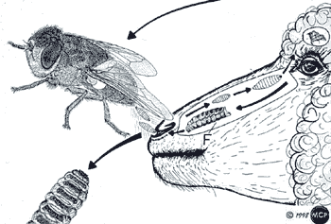
Oestrus ovis

Slide 23
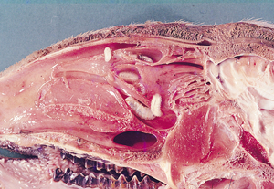

Slide 24
Vector

Slide 26
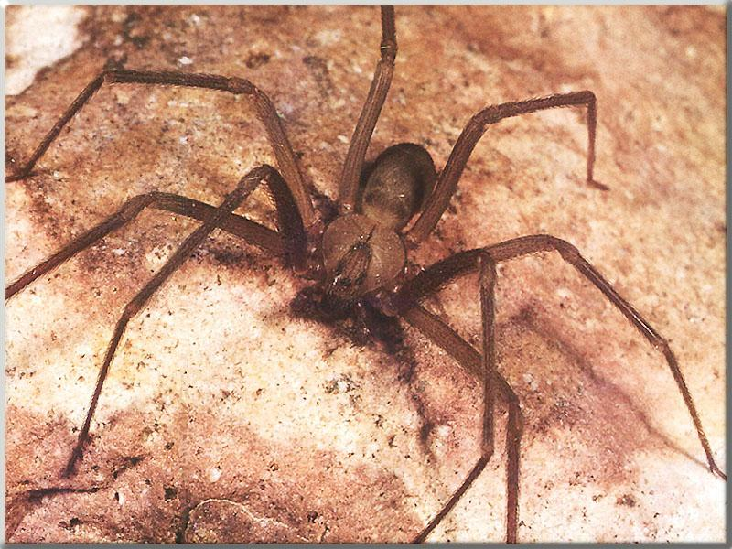
Class: Arachnida (Arachnids) Order :Araneae (Spiders) Family: Theridiidae (Brown widow Spiders) Loxosceles laeta
Loxosceles laeta

Slide 27
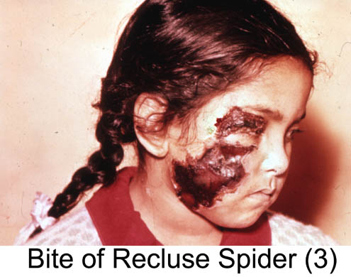

Slide 28
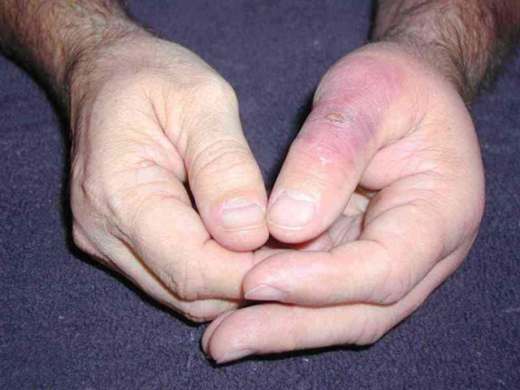
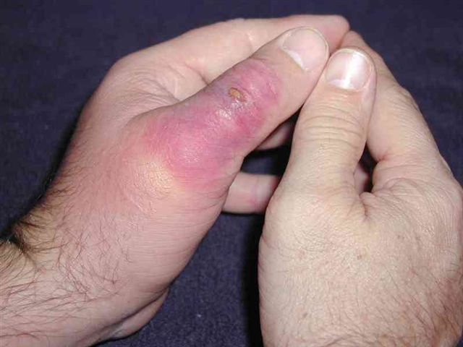
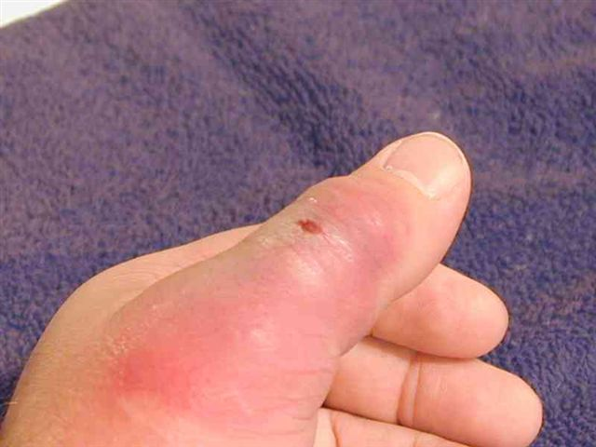
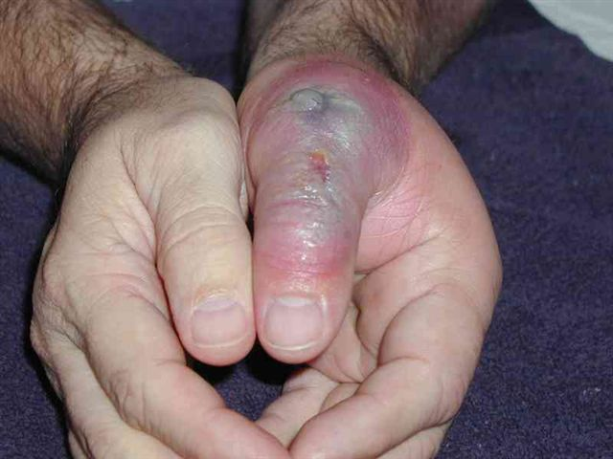
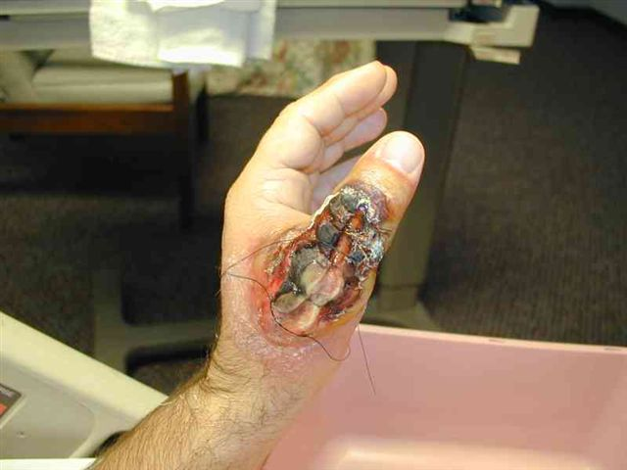
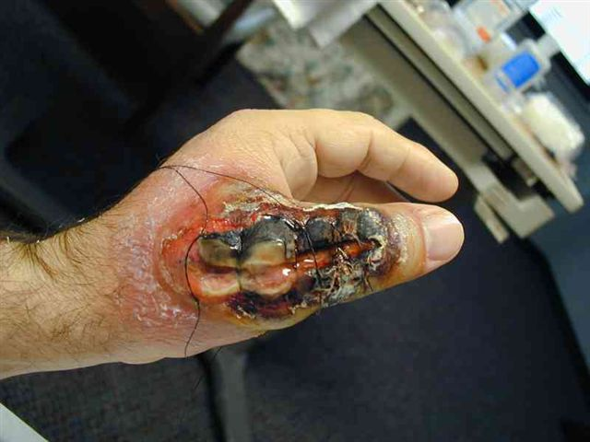
Progression of Bite (3-10 days)

Slide 29
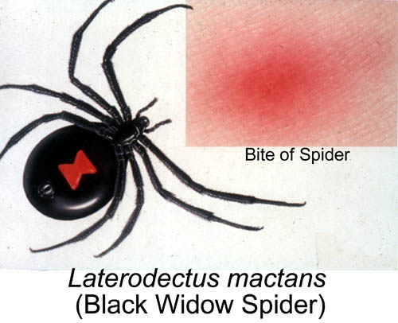

Slide 30
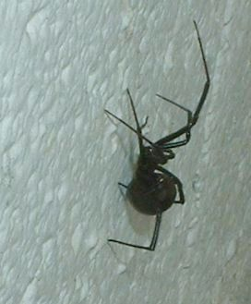
Class: Arachnida (Arachnids) Order :Araneae (Spiders) Family: Theridiidae (Black widow Spiders)
گونه هاي سمي عنكبوتهاي بيوه مشاهده شده درايران
Latrodectus dahli داهلی
L.Pallidus پالیدوس
L.geometricus ژئومتریکوس
L.Tredecimguttatus تردسیمگوتاتوس

Slide 31
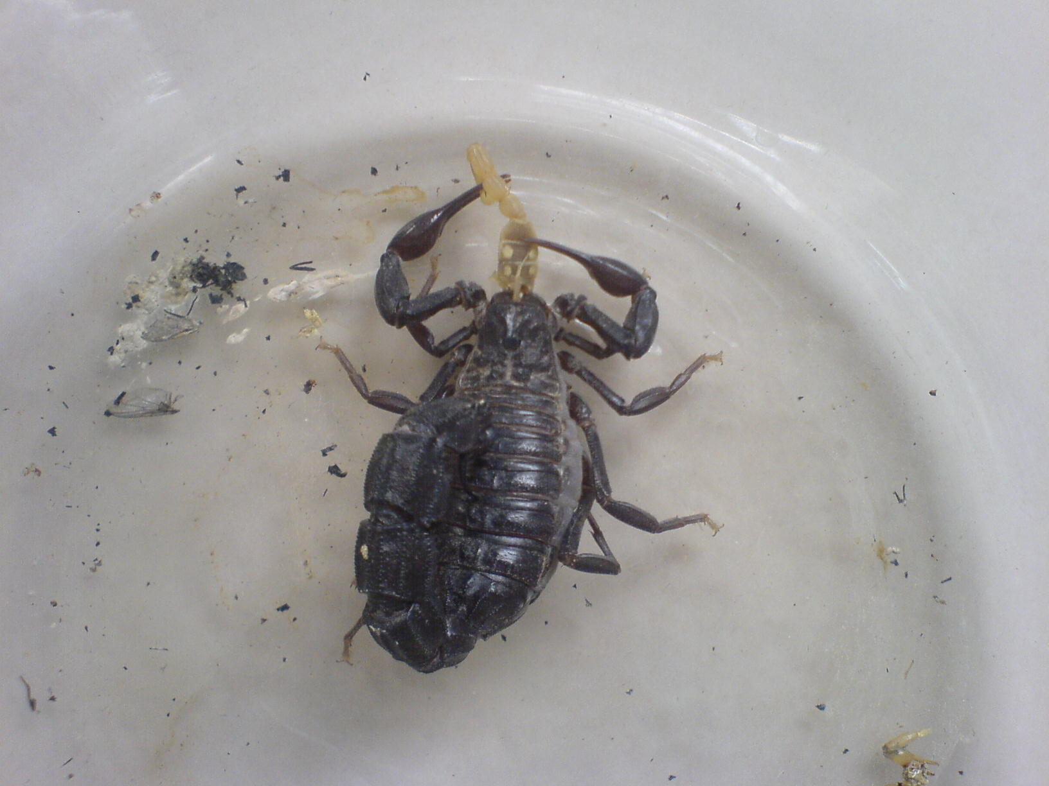
Androctonus crassicauda

Slide 32
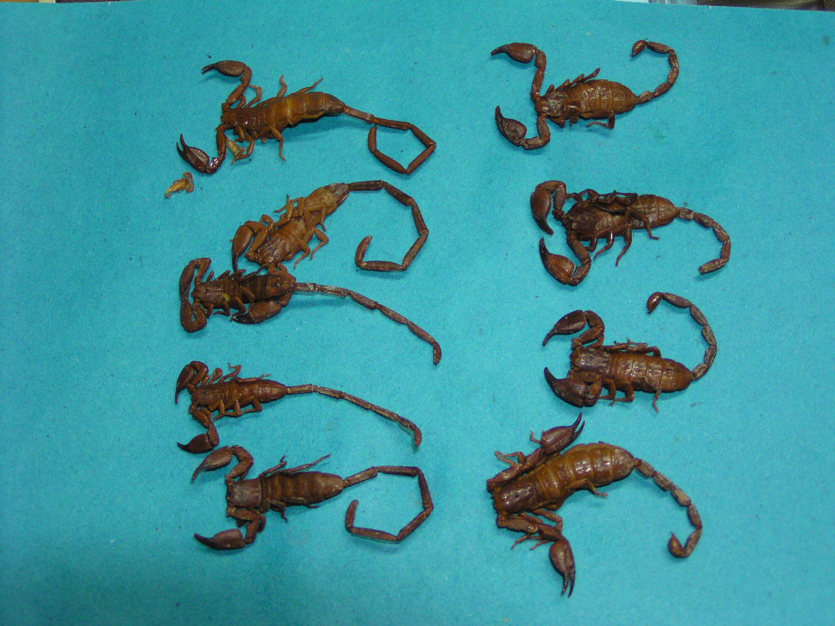
Hemiscorpius lepturus
Male
Female
D.R.D

Slide 33
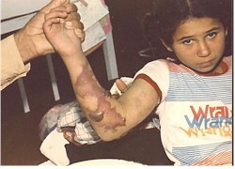

Slide 36
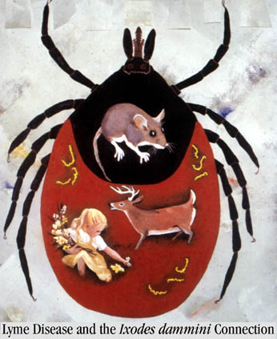
The order Acarina includes mites and ticks

Slide 37
Basic drugs for the phlebotomist
Anticoagulants
Vasodialators
Anesthetics
Immunomodulators
(An immunomodulator is a drug used for its effect on the immune system.
There are two types of such drugs based on their effects:
immunosuppressants and Immunostimulators )

Slide 38
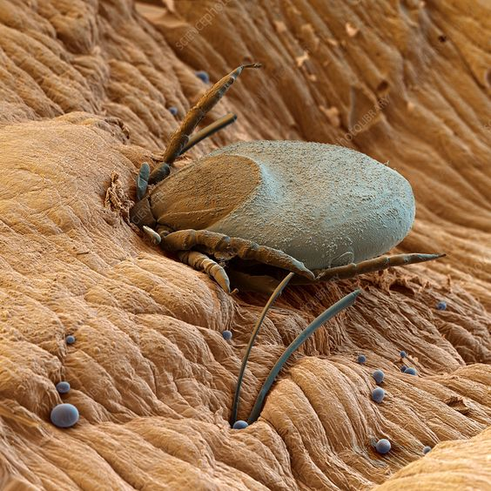
Tick feeding on human blood

Slide 39
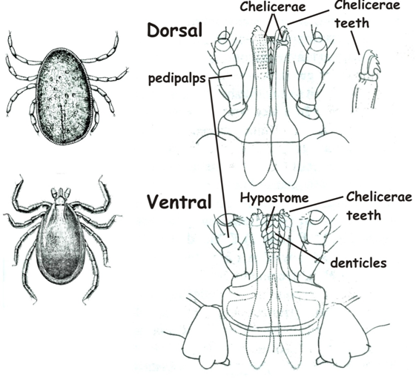
Argasid Capitulum
Ixodid Capitulum

Slide 40
Tick borne diseases (hard tick) Tick paralysis or Ascending paralysis
Tick paralysis
Hard ticks inject into the body with their saliva certain toxins that can cause a condition in people and animals called tick paralysis.
It appears 5-7 days after a tick begins feeding, paralysing the legs and affecting speaking ability, swallowing and breathing.
It occurs worldwide and is most common and severe in children aged up to two years.
Treatment involves removing the tick.

Slide 41
Viral diseases:
Kyasanur Forest disease
Omsk haemorrhagic fever
Russian spring-summer encephalit
Crimea-Congo haemorrhagic fever
Hantaan virus
Colorado tick fever
Tick borne encephalit
Powassan*
Louping ill*

Slide 42
Rickettsial diseases:
Sibrian tick typhus Rickttsia siberica
Fever boutonneuse R.conori
Q fever Coxiella burnetii
Rocky Mountain spotted fever R. rickettsi
Queensland tick typhus R.australis
Spirochaetal disease:
Lyme disease Borrelia burgdorferi
Protozoal diseases:
Babesiosis Babesia microti and bovis
Bacterial disease:
Tularemia Francissella tularensis

Slide 43
Tick borne diseases (soft tick)
Tick borne relapsing fever
Borrelia persica
Vector Ornithodorus tholozani
Borrelia microti
Vector Ornithodorus erraticus
Borrelia latischevi
Vector Ornithodorus tartacowsky
Borrelia duttoni
Vector Ornithodorus moubata
Q fever Coxiella burnetii
Transovarial transmission

Slide 44
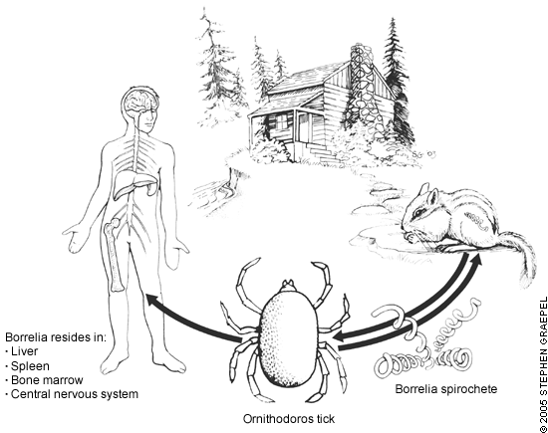
Death occurs in about 2-10% of persons who are untreated

Slide 45
Repellents
Effective repellents that prevent ticks from attaching to the body include
Deet
Dimethyl phthalate
Benzyl benzoate
Dimethyl carbamate
Indalone
These substances can be applied to the skin or clothing.
On the skin, repellents often do not last more than a few hours because of absorption and removal by abrasion.
On clothing they last much longer, sometimes for several days .
For more information on repellents

Slide 46
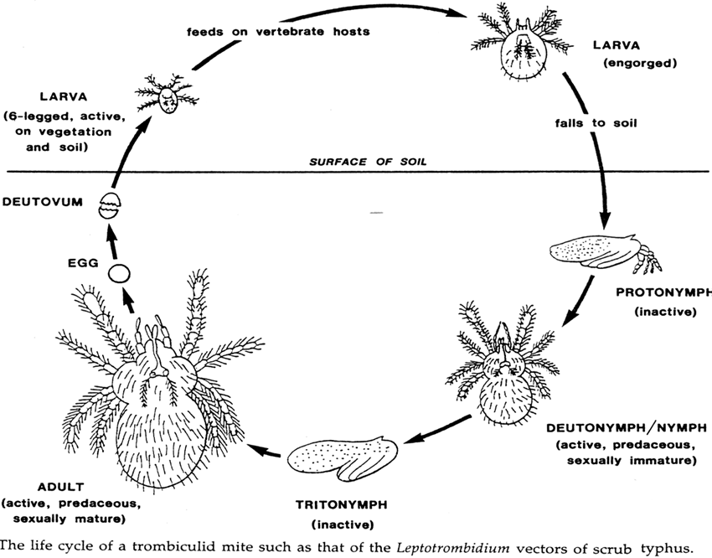

Slide 47
Chigger (mite) borne disease
Scrub Typhus
Trombicula akamushi (vector)
Rickettsia tsutsugamushi (pathogen)
Scrub itch (Trombicula autumnalis)

Slide 48
Family Dermanyssidae

Slide 49
Mite borne disease
Rickettsial pox
Allodermanyssus sangeuneus (vector)
Rickettsia akari

Slide 50
House dust mites
Family Pyroglyphidae = few species found in house dust
European house dust mite (Dermatophagoides pteronyssinus) is common & occurs worldwide
Minute & very difficult to see
House dust samples may contain 1000s of mites
Prefer damp conditions & live in beds, pillows, rugs & carpets
Feed on shed human skin
Infestations increased by high humidity
More abundant in beds & become airborne when beds are made or pillows fluffed
Inhalation causes allergic reactions in respiratory tract
Asthma & rhinitis
Allergens in bodies of dead & living mites; also in mite fragments & faeces
House dust mites cause 25% of all allergies and 50% of all asthmatic diseases are traceable to house dust mites

Slide 51
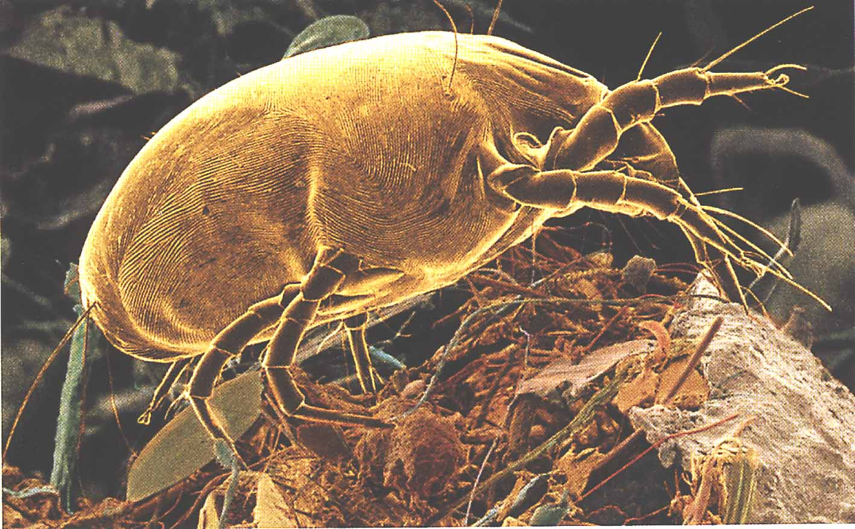
The house dust mite (Dermatophagoides pteronyssinus)

Slide 52
Sarcoptes scabiei
Females make permanent winding (spiral) burrows (1 cm long) in horny layer of skin
Burrow initiated by mouth parts & blade-like claws on forelegs
Burrow formed by constant growth of epidermis
Eggs laid in burrows & immature stages move to skin surface
Immatures shelter & feed in hair follicles
Burrows occur mostly in inter-digital & elbow skin
Also in genital area, breasts, knees, buttocks ,
Burrows are lost as horny epidermal layers are shed

Slide 53
Scabies (mange) mites

Slide 54
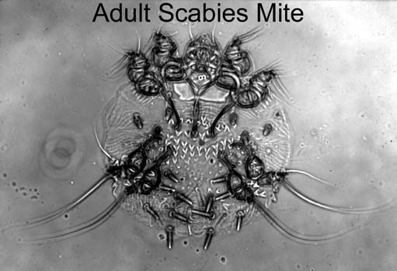
Seven year itch Norwegian itch Scabies

Slide 56
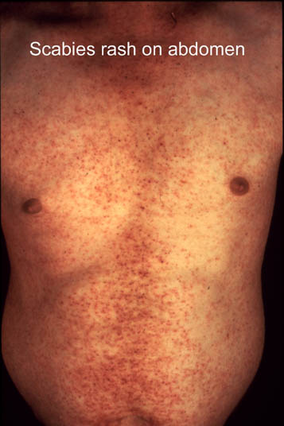

Slide 57
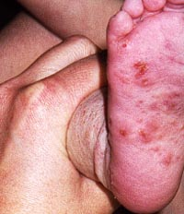
Scabies are mites that cannot be seen by the naked eye.
They burrow under the skin causing intense itching 6-8 weeks after they have initially affected the skin

Slide 58
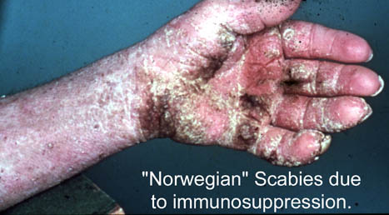

Slide 59
Formulations of insecticides which can be applied as creams, lotions or aqueous emulsions for use against scabies
Insecticide | Formulation
benzyl benzoate Crotamiton topically Mitigal topically Tetmosol topically | 20-25% emulsion
sulfur | in oily liquid
Lindane and BHC | 1% cream or lotion
malathion | 1% aqueous emulsion
permethrin | 1% soap bar or 5% cream
Ivermectin | a single oral dose of 100-200 mg per kg of body weight

Slide 60
Follicle mites
Genus Demodex (Demodicidae)
Minute (0.1-0.4 mm) with annulated worm-like bodies & very short legs
Live with heads down in hair follicles & sebaceous glands of humans & animals
2 species infest humans
Demodex folliculorum (hair follicles) & D. brevis (sebaceous glands)
Occur mainly in facial area, eyelids & around nose
Mostly benign, but in extreme cases can cause dry rashes & facial acne

Slide 61
Follicle mites

Slide 62
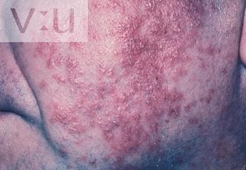

Slide 63
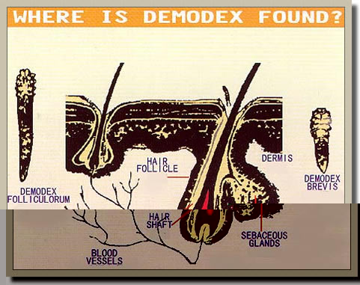

Slide 64
Side effects : Pyoderma ,Belpharit,
Treatment
Danish
Sulfur %10
Benzyl benzoat
Balsam of peru

Slide 65
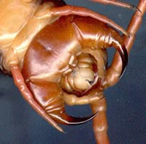
Ventral Head of centipede

Slide 66
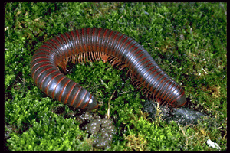
Millipedes - Class Diplopoda
Millipedes (2 legs/body segment) do not have biting mouthparts or fangs. Their medical importance comes from their ability to secrete an irritating defensive liquid from pores along their sides.
Such secretions contain benzoquinones, aldehydes, hydrocyanic acid, and other substances.

Slide 67
Parasitic Crustaceans
Mostly relevant as vectors
Most important to humans are from the
Copepods
Cyclops spp.
Dracunculus medinensis
Diaptomus spp.
Diphyllobothrium latum

Slide 68
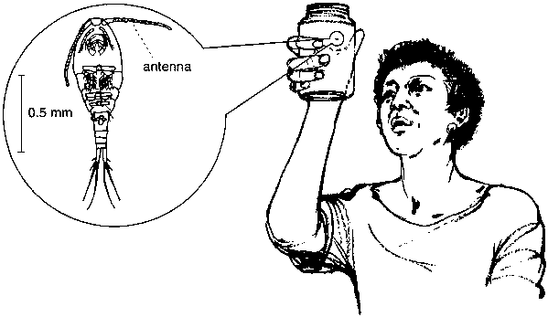
Cyclops can be seen in pond water, collected in a glass jar, as minute dots swimming jerkily.
On the left, cyclopsas it appears under a microscope.

Slide 69
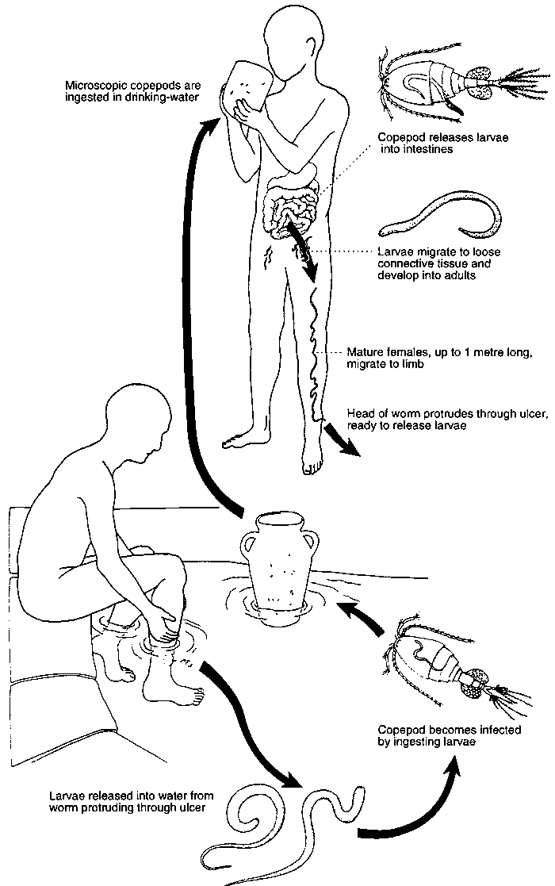
Life cycle of guinea worm

Slide 70
Order Anoplura -real lice!
1) apterous
2) body dorso - ventrally flattened
3) ectoparasites of human
4) sucking (haustellate) or biting mouthparts
5) claws modified for grasping host

Slide 71
2. All lice are wingless
3. Body flattened in a dorsoventral axis
4. Legs adapted for clinging to hairs and
feathers
5. Simple metamorphosis
(egg - nymph - adult)
6. PEDICULOSIS - infestation with lice,
"Vagabond's Disease" - hardened, deeply pigmented skin associated with continual louse infestation

Slide 72
Species of Louse order Anoplura
Pediculus capitis(Head louse)
(general appearance of louse)Flat body, mouthparts that pierce and suck blood, 2 antennae ,3 pairs of short legs with claws
2-3 mm long
Dirty white to greyish black colour
Thick antennae
Pediculus humanus (corporis)(Body louse)
2-4 mm long
Often light coloured
Phthirus pubis(Crab louse)
0.8-1.2 mm long

Slide 73
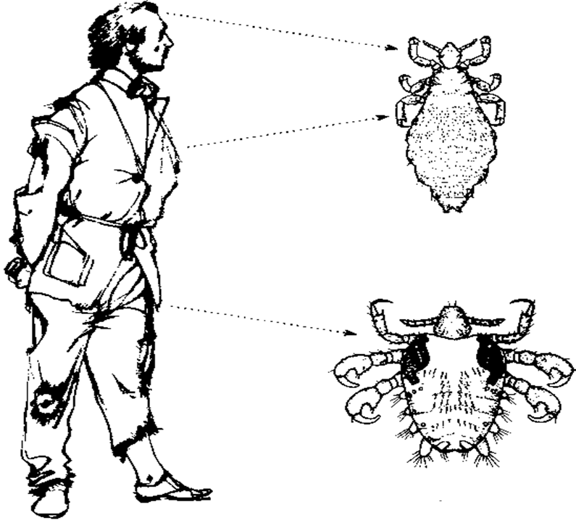
سیمای ولگرد(Vagabond) آلوده به شپش ( Pediculosis)
شپش سر و شپش بدن و زیستگاه آن در بدن انسان
Vagabond’s disease
شپشک عانه یا زهار و زیستگاه آن در بدن انسان

Slide 74
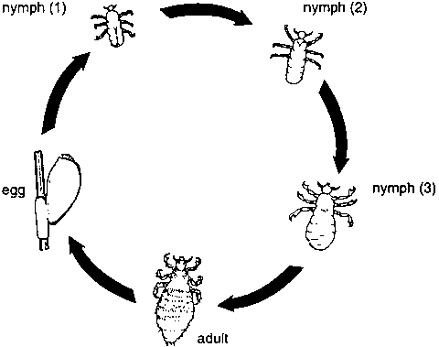
Life cycle of the louse
Nits or eggs

Slide 75
Louse-Borne Pathogens

Slide 76
Louse-Borne (Epidemic) Typhus
1. Pathogen - Rickettsia prowazekii (rickettsia)
2. African highlands, especially Burundi, Rwanda and Ethiopia; in Bolivia and mountainous areas of Ecuador; scattered
elsewhere in Africa, Europe, Asia, and Central and South America
Vector - Pediculus humanus
Brill zinsser disease

Slide 77
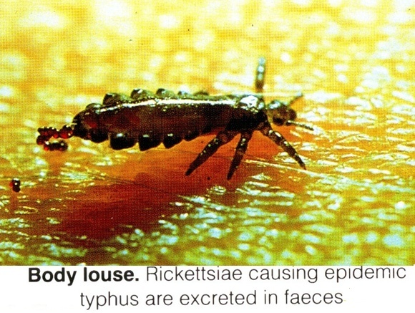

Slide 78
Trench Fever(Volhyni disease)
1. Pathogen - Rickettsia (Rochalimaea) quintana (bacteria)
2. Worldwide distribution, but local foci
3. Vector - Pediculus humanus
4. Transmission through feces or body contents of crushed louse
6. Reservoir is human, occurs under conditons similar to epidemic typhus

Slide 79
Epidemic Relapsing Fever
1. Pathogen - Borrelia recurrentis
2. Africa, especially Ethiopia; only scattered foci and sporadic occurrence elsewhere, epidemics in Europe during WWI and WWII
3. Vector - Pediculus humanus
4. Transmission to human by crushing infected louse

Slide 80
Nuisance(Pediculosis)
Only the body louse is a vector of human diseases and It transmits:
Typhus fever( Exanthematic or Epidemic Typhus)
Relapsing fever ( Epidemic relapsing fever )
Trench fever (Volhyni disease)
Lice feed several times a day and heavy infestations can cause intense irritation and severe itching.
Toxic reactions to the saliva injected into the skin may lead to weariness and a general feeling of illness.

Slide 81
Louse Control
Body Lice – change and wash clothing in water hotter than 60C.
In epidemic situations, 10% DDT in talc dusted on between body and underclothes
(other insecticides – 1% malathion, 2% temephos, 1% propoxur, 0.5% permethrin).
Head Lice – soap and water washing for adults and nymphs. Combing to remove nits or shaving head. Insecticides, but resistance in many areas of the world.
Pubic Lice – insecticidal emulsions and lotions. Resistance not as much of a problem.
1% permethrin – reapply because eggs not killed.
0.5% malathion – kills eggs too.

Slide 82
Order Hemiptera- bugs
1) piercing, sucking mouthparts
2) beak originates from the front of the head
3) wings usually membranous in the distal portion but more leathery basally
Order Hemiptera have two medical importance families:
Cimicidae:Two species of bedbug feed on humans:
the common bedbug (Cimex lectularius), which occurs in most parts of the world, and the
tropical bedbug (Cimex hemipterus), which occurs mainly in tropical countries.
Reduviidae: Triatomine bugs (Assassin bugs, Kissing bugs, Cone-nosed bug, Reduviid bugs)
Triatomma infestance
Rhodnius prolixus
Panstrongylus megistus
Vector for Trypanosoma cruzi (Chagas disease)

Slide 83
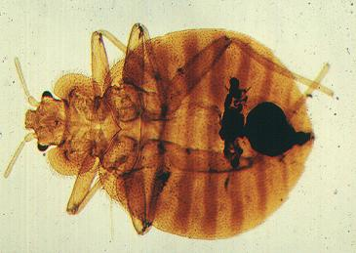
Image of the common Bedbug Cimex lectularius
Bedbugs have a flat, oval-shaped body with no wings, and are 4-7 mm long

Slide 84
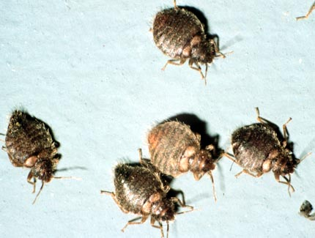
Dispersal :Because they have no wings, bedbugs travel only short distances
Public health importance

Slide 85
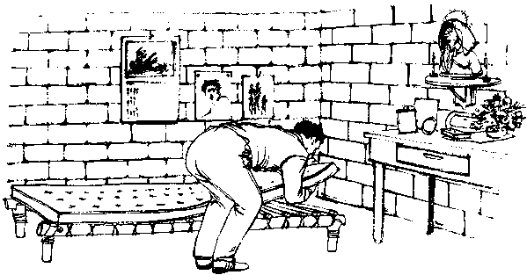
Bedbugs are almost always found in bedrooms.

Slide 86
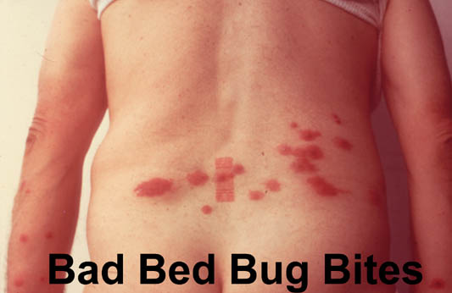

Slide 87
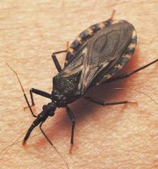
Triatomine bugs (Assassin bugs, Kissing bugs, Cone-nosed beetles, Reduviid bugs) are of variable size but are often large (10-30 mm).

Slide 88
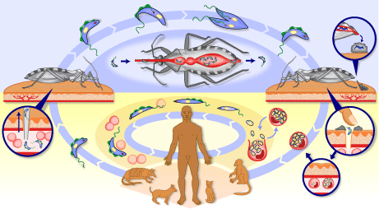

Slide 89
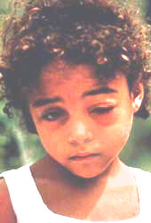
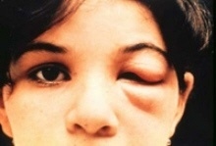
Chagas disease: Romana’s sign or chagoma sign
A typical early symptom of Chagas disease is swelling of the eyelid, known as Romaña’s sign.

Slide 90
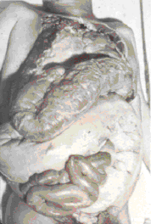
Symptoms : Cardiomegaly, Megacolon , Megaesophagus

Slide 91
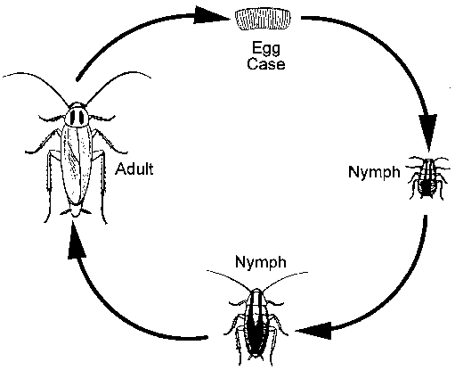
Cockroach Order Dictyoptera, formerly Orthoptera
Some 4000 species, but <1% are medically important as domestic pests (50 sp.)
fast-running, nocturnal
Simple Metamorphosis:
5-12 nymphal instars (depends on species and sex)
ootheca (egg case) with 12-50 eggs
Ootheca - desiccation-resistant, may be carried 2-3 days or weeks
Life span >2 years under poor conditions

Slide 92
important species of cockroach order Dictyoptera
Blatella germanica
Blata oriantalis
Periplaneta americana
Supella longipalpa

Slide 93
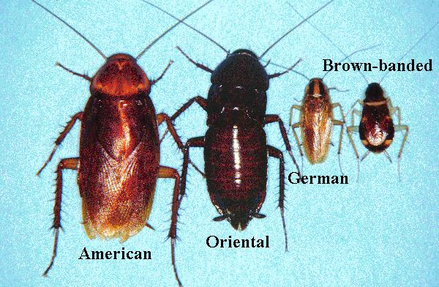

Slide 94
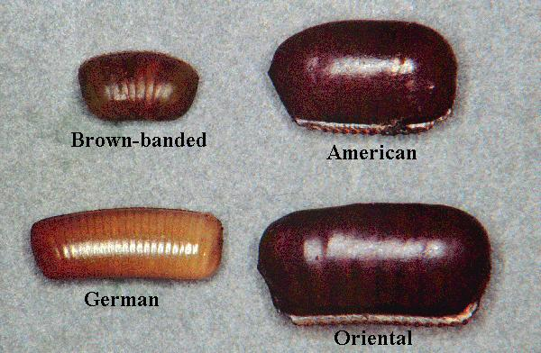

Slide 95
Diseases
Cockroaches move freely from building to building or from drains, gardens, sewers and latrines to human habitations.
Because they feed on human faeces as well as human food they can spread germs that cause disease .
Cockroaches are not usually the most important cause of a disease, but like houseflies they may play a supplementary role in the spread of some diseases.
They are proven or suspected carriers of the organisms causing:
- diarrhoea - dysentery - cholera - leprosy - plague - typhoid fever - viral diseases such as poliomyelitis.
In addition they carry the eggs of parasitic worms and may cause allergic reactions, including dermatitis, itching, swelling of the eyelids and more serious respiratory conditions

Slide 96
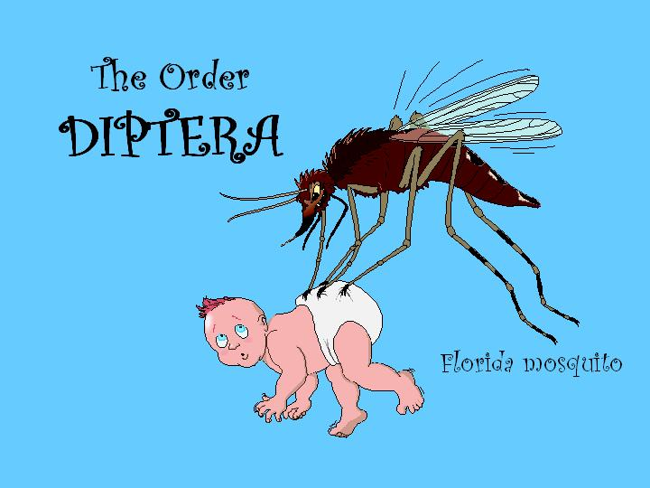

Slide 97
Order Diptera
suborder Nematocera:
Culicidae
Psychodidae
Simulidae
Ceratopogonidae
suborder Bracycera :
Tabanidae
suborder Cyclorrhapha:
Muscidae
Calliphoridae
Sarcophagidae
Oestridae

Slide 98
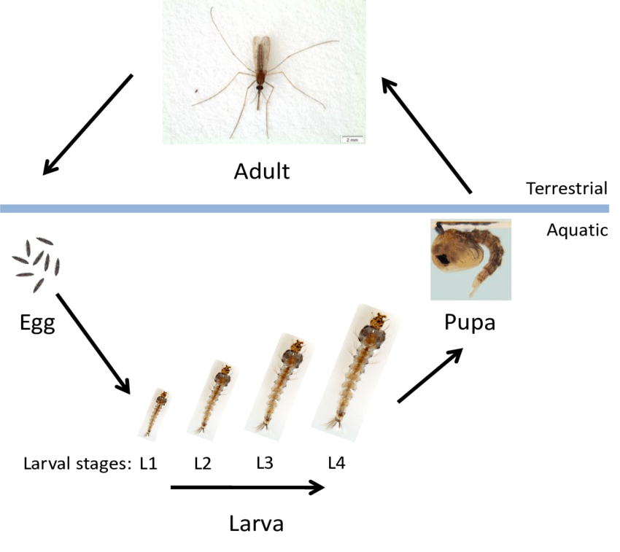
Life Cycle:The mosquito goes through four separate and distinct stages of its life cycle: Egg, Larva, Pupa, and Adult. Each of these stages can be easily recognized by its special appearance.

Slide 99
Aedes, Anopheles and Culex larvae.
An indication of the genera of mosquito larvae can be made from the length of the siphon. Anopheles have very short siphons (see below also), while Culex tend to have the longest siphons.

Slide 100
Aedes, Culex larvae and pupa. Both Aedes and Culex larvae hang down from the water surface at an angle.

Slide 101
Mansonia larva. These larvae have highly developed siphons, which are adapted for piercing plant tissue. It is from here that they obtain their oxygen (rather than the water surface).

Slide 102
Mosquitos
Mosquitos differ from the other biting Diptera in having a long slender body, long legs and long needle-shaped mouthparts
The wings sometimes have discernible patterns of scales.
The adult insects measure between 2 mm and 12.5 mm in length.

Slide 103
Biting behaviour
Female mosquitos feed on animals and humans. Most species show a preference for certain animals or for humans.
They are attracted by the body odours, carbon dioxide and heat emitted from the animal or person.
Feeding usually takes place during the night but daytime biting also occurs.
Anthropophilic and Zoophilic

Slide 104
MOSQUITOES AS DISEASE VECTORS
-Encephalitis (5 types)
Western Equine Encephalitis – Culex tarsalis
-West Nile Virus – Culex pipiens (East), C. tarsalis (West)
-Dengue – Aedes aegypti
-Yellow fever – Aedes aegypti
-Malaria – Anopheles spp.
-Filariasis (nematodes) – Culex, Aedes, Anopheles spp.
-Dog heartworm – Culex, Aedes spp.

Slide 105
Anopheles mosquitoes
More than 470 Anopheles mosquitoes specieses
More than 60 specieses are vector of malaria
we have 31 specieses of Anopheles In Iran
8 specieses of them are vector:
Anopheles superpictus
Anopheles maculipenis
Anopheles sacharovi
Anopheles dthali
Anopheles fluviatilis
Anopheles culicifacies
Anopheles stephensi
Plasmodium falciparum
Plasmodium vivax
Plasmodium malariae
Plasmodium ovale

Slide 106
Wuchereria bancrofti, is mainly transmitted by Culex quinquefasciatus
and by some Anopheles
and Aedes species.
Elephantiasis (permanent swelling) of the leg due to lymphatic filariasis.

Slide 108
Arboviruses (arthropod-borne viruses)
West Nile Virus:Basic Transmission Cycle
Enzootic (Maintenance/Amplification)
Epidemic
Incidental hosts
Epizootic
Amplifying hosts

Slide 109
BLACK FLIES LIFE CYCLE
Adult
Eggs on a submerged
water plant
Larvae in feeding
position
Emerging adult
in air bubble
Pupae

Slide 111
Psychodidae (moth flies, sand flies)
Mostly harmless, except blood-sucking sand flies (subfamily Phlebotominae)
Transmit several pathogens
Protozoa (leishmaniasis)
Arboviruses (pappataci fever)
Bacteria (oroya fever)
Identification
Small cryptic flies (2-4 mm)
Very broad & hairy wings with long parallel veins
Wings held open over body

Slide 112
Sandfly (Phlebotumus 2-4 mm,small hairy flies with pointed elliptical wings )

Slide 113
3 important genera and some others of lesser importance
Old world
Phlebotomus
Sergentomyia
New World
Lutzomyia
Warileya
Brumptomyia

Slide 114
Sandflies
Sandflies are small bloodsucking flies that are important as vectors of
leishmaniasis (3 major forms)
sandfly fever, a viral disease also known as Pappataci fever or three-day fever
an Arbovirus in the Mediterranean/Asia/India area producing a non-fatal, febril illness
Bartonellosis or Carrion's disease or Oroya disease (Bartonella bacilliformes)
in South America; bone, joint, and muscle pains; occasionally death

Slide 115
Sandflies species
Phlebotumus papatasi
Phlebotumus major
Phlebotumus sergenti
Phlebotumus argentipes
Phlebotumus ariasi
Phlebotumus perniciosus
Phlebotumus alexanderi
Phlebotumus caucasicus
Phlebotumus halopensis
Phlebotumus balcanicus
Phlebotumus kandelakii
Phlebotumus saleh

Slide 116
Cutaneous leishmaniasis
is known under a variety of common names such as oriental sore, clou de Biskra, Aleppo boil, Bahia ulcer and chiclero’s ulcer.
It is caused by, among other species, Leishmania major
L. tropica
L. aethiopica

Slide 117
Localised Cutaneous Leishmaniasis

Slide 118
Visceral leishmaniasis

Slide 119
Leishmania braziliensis:
New World mucocuntaneous leishmaniasis

Slide 120
6-25mm

Slide 121
Tabanidae are of minor importance as vectors of diseases, such as
Tularaemia
Arboviral diseases.
Loaisis
This disease is caused by the filarial parasite Loa loa.
Chrysops is vector
Loaisis occurs only in woods and forests in West and Central Africa, from Benin to Uganda and southern Sudan.

Slide 122
Muscidae
Musca domestica - the house fly
Synarthropy - close relationship with man - frequent table and outhouse.
Life cycle - Eggs deposited on decaying organic matter. Larva is a common maggot. Pupal stage in soil or drier areas for 4 to 5 days.
Pathology - excellent vector, it vomits to digest food and defecates at random.

Slide 123
The life cycle of the fly

Slide 124
.
People who keep cattle are sometimes surrounded by large numbers of filth flies (Musca sorbens), important vectors of certain eye infections

Slide 125
HOUSE FLY
Sponging mouthparts
A carrier of up to 40 diseases, including:
typhoid fever, cholera, dysentery, and anthrax.
The fly transmits diseases by carrying disease organisms onto food. It picks up disease organisms on its leg hairs or eats them and then regurgitates them onto food (in the process of liquefying solid food)

Slide 126
The diseases that flies can transmit
include enteric infections such as:
dysentery
diarrhoea
Typhoid
cholera
and certain helminth infections)
eye infections (such as trachoma and epidemic conjunctivitis)
poliomyelitis
and certain skin infections (such as yaws, cutaneous diphtheria, some mycoses and leprosy).

Slide 127
Stomoxys calcitrans - stable fly
A stable fly(5-6mm)
Morphology - Resembles house fly but has biting/sucking mouth parts: pointed, shiny black proboscis, bayonet-like in front of head.
Aristae (bristles) on antennae have setae (hairs) on upper sides only.

Slide 128
STABLE FLY
Bayonet-like mouthparts Stable fly House fly
Both male and female are blood-sucking
Attracted to dark colors
Breeding sites: manure, straw
Control: similar to house flies
SANITATION!

Slide 129
Stable flies (Stomoxys calciteranas) occur around the world
They are not important as vectors of disease.
However, in South America they sometimes play a role in the transmission of myiasis by carrying the eggs of the myiasis-producing fly Dermatobia hominis.

Slide 130
African Sleeping Sickness
Caused by Trypanosoma gambiense and T. rhodiense.
T. gambiense causes a chronic form that is found in west central and central Africa.
Attacks CNS, often fatal
Wild animals do not serve as reservoir hosts
T. rhodiense causes an acute form in east central and central Africa.
Wild animals serve as reservoir hosts.

Slide 131
Tsetse flies are robust, 6-15 mm in length
can be distinguished from other biting flies by their forward-pointing mouthparts (proboscis) and characteristic wing venation .
There are about 30 known species and subspecies of tsetse flies belonging to the genus Glossina
They can be divided into three distinct groups or
Glossina fusca
Glossina palpalis
Glossina morsitans

Slide 132
African sleeping sickness usually starts with headaches, irregular fevers, swollen( inflamed) tissues and joint pains.
At a later stage the brain becomes affected, which results in mental deterioration, coma (the sleeping stage) and death

Slide 133
Myiasis
Infestation of the organs and tissues of humans or animals by fly larvae that for some period of time, feed upon the living or dead tissues or the ingested food of the host

Slide 134
Myiasis is clinically classified as:
– Dermal and Subdermal myiasis
– Facial cavity myiasis
– Wound or traumatic myiasis
– Gastrointestinal myiasis
– Vaginal myiasis
– Generalized myiasis

Slide 136
Calliphoridae
Aucmeromyia senegaliansis (congo floor maggot) haematophage
Calliphora(Wound, eyes)
Chrysomyia bezziana Old World screw-worm( Wound , cavity)
Cochliomyia hominivorax New World screw-worm (Wound , cavity, skin)
Cordilobia anthropophaga or tumbo fly(skin)
Phormia (Wound)

Slide 137
Oesteridae
Dermatobia hominis (skin) transmition by stable fly
Gasterophylus (cavity and digestive system
Hypoderma (skin)
Oesterus ovis
Oesterus ovis (cavity , eyes)
Rhinoesterus (cavity , eyes)
Sarcophagidae
Sarcophaga(Wounds)
Wohlfahrtia magnifica (Wound , cavity, skin)

Slide 139
Egg
3 larvae
Pupa
adult

Slide 141
A 13-year-old boy from a rural area in Hamadan

Slide 143
Furuncular breast lesion with multiple sinuses containing Tumbu fly larvae.

Slide 144
One of the sinuses after extraction of the Larva.

Slide 146
Maggot Therapy Project

Slide 148
Siphonaptera (fleas)
Small 1-4 mm, laterally flattened, wingless insects
Large hind legs & spectacular jumps
Parasitic on birds & mammals
All adults have piercing & sucking mouth parts & feed on blood
Annoying pests due to blood sucking, skin burrowing & transmission of diseases & parasites

Slide 149
Very small (<1 mm)
Females burrow into skin of humans & other mammals; usually on feet
Soft areas between toes
Under toenails
Condition called tungiasis
Tunga penetrans (the Chigoe or jigger flea)

Slide 151
Plague
Plague is a disease caused by the bacterium Yersinia pestis.
It occurs primarily in wild animals, such as rats and other rodents.
Plague bacteria are transmitted by fleas, and humans may be infected by fleas that have fed on infected animals.
In the past, plague was called the black death and caused disastrous epidemics

Slide 152
Plague is still dangerous because it occurs widely in rodent populations.
Rural or Sylvatic plague may be contracted in the western USA, South America, Africa, the former USSR, parts of the eastern Mediterranean area, and central and southeast Asia.
Human plague frequently occurs in several countries in Africa, Bolivia/north-eastern Brazil, Ecuador, Myanmar, Peru and Viet Nam .
Urban plague is acquired by people entering rural areas and handling wild animals.
Most at risk are hunters who may be bitten by infected fleas while handling recently killed animals.

Slide 153
plague

Slide 155
Other diseases
Fleas occasionally transmit other diseases and parasites from animals to humans, for instance
Flea-borne typhus, also called murine typhus fever, is caused by Rickettsia typhi and occurs sporadically in populations of rats and mice
tularaemia caused by the bacillus
Francisella tularensis,
and the parasitic tapeworms :
Diplididum caninum
Hymenolepis diminuta that occur in dogs and cats.
Children playing with domestic pets may become infected by swallowing fleas that carry the infective stage of the worms

Slide 156
Honey bee with a stinger

Slide 157
Toxicity & fatalities
Most fatalities caused by honey bees
Shock from multiple stings
Allergic response (anaphylaxis) from single sting
In non-sensitized people, LD50 varies
500 stings for children
1100 for adult females
1400 for adult males
Allergic people must avoid allergens & carry medication

Slide 158
The Bee Sting has a barbed outer sheath which are like a fish hook - easy to insert but difficult to extract
The Wasp Sting has a smooth outer lining - easy to insert in and out of the victim

Slide 159
Not all toxins inoculated via stings
Physical contact with body parts, haemolymph, poisonous spines & defensive secretions
Blister beetles (Meloidae) release toxins (cantharidins) when crushed or handled
Cause blistering of skin
Cause inflammation of urinary & genital tracts if taken orally (aphrodisiac ‘Spanish fly’)

Slide 160
Skin blistering

Slide 161
Body fluids of other beetles have potent toxins
Certain flea beetles (Chrysomelidae) that feed on toxic plants are used for arrow poisons by San people
Some rove beetles of genus Paederus (Staphylinidae) have contact poisons (paederin) that cause blistering & long-lasting ulceration

Slide 162
Paederus fuscipes (Coleoptera:Staphylinidae)
Paederus beetle
Ulcers from paederin

Slide 163
Urticating hairs
Penetrate skin causing skin irritations (urtication)
Retain irritant properties long after being shed
Intense burning sensation on skin
Breathing difficulties if inhaled
Inflammation of mouth & throat if ingested

